Slide 1
Microservices and DevOps
DevOps and Container Technology
The Exam
Henrik Bærbak Christensen

Slide 2
A note on Evaluation
One fagpakke = three courses
Standard Science Faculty procedure
  Evaluation after each course
  Has ended in some minor issues
Handleplan 2019: Evaluation after fagpakke
But I would like to get anonymous feedback
  (Anything you wish to say in person is also highly appreciated ☺)
However – Too soon today, I feel…

Slide 3
So…
I will issue an evaluation later in the course. Stay tuned…

Slide 4
Exam

Slide 5
Practicalities
When and Where?
  Check the course web site for date and time
  Location: In a
How
  Jump into Zoom 10-15 minutes before start time
    Ensure your machine is doing well, network is ok, etc.
  You get a web link with the exam question
  You solve as much as possible
  You upload required hand-in material to ‘exam’ exercise on BS and you upload your image(s) to Docker Hub.
  … and I review your stuff

Slide 6
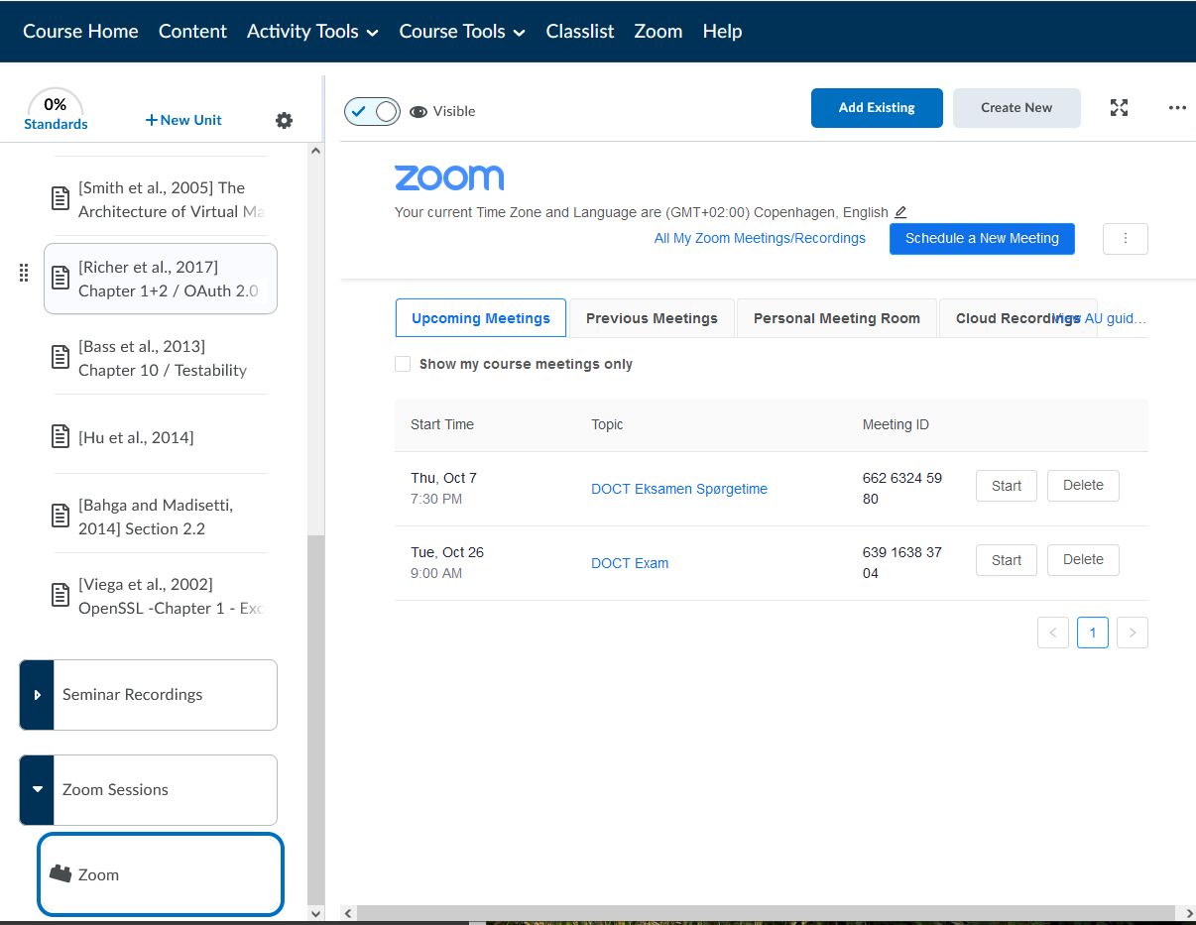
To prepare
Perhaps some of you are new to Zoom.
Meet with me to a Q&A session before the exam to test out the tools
  find the link on BS
Exam link is same place

Slide 7
Format
The exam is individual !!!
Preparation
  Get your own bitbucket/github/svn account which is private !!!
  Get your own docker hub account, and a private repository !!!
  Ensure your SCM repository contains the latest SkyCave source
  Ensure you can push and pull images to your docker hub
    Ensure I am collaborator

Slide 8
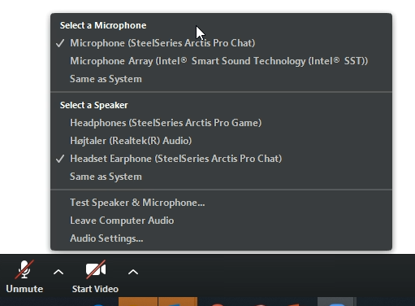
Arrive Early ☺
Please join at least 10 minutes before
  Start your audio and video
  initially, so we can ‘meet’
  It takes a bit of time for me to
  admit you into the meeting…

Slide 9
‘Udeblevet’
If you do not see you in the Zoom meeting with Video (initially), I will note your participation at the exam as ‘udeblevet’
  Which is failed ☹
So – it is not enough just to happy-go-lucky upload something to BS …

Slide 10
Once all have joined
You will be given the link to the exercise as a web page
I will introduce the exam exercise
Once everybody has acknowledged they can get the exercise web page…
I will start the 1½ hour timer

Slide 11

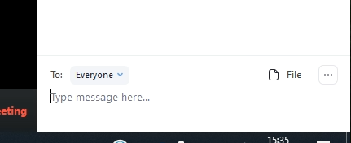

During Exam
Mute your Audio ☺
Video
  I will ask you to keep your video running… Exam supervision!
Questions during exam:
  Use the Chat to
  ‘Henrik Bærbak Chr.’
  Can also upload files
    But slow process ☹
    And I can only clarify!
To Henrik Bærbak

Slide 12
Solve the Exercises
Solve the four exercises
  Timebox the third exercise (make a ‘command’ in daemon)
  So you have time to do something on the fourth (compose file)
15 minutes before deadline
  I will notify you, begin to consider upload to hub and BS
5 minutes before deadline
  Begin to upload to hub and BS !!!
0 minutes
  Exam finishes, uploads started before the 0 minute mark may finish, of course

Slide 13
If Shit Happens
If you run into a major stumbling block
  Ala ”I simply cannot make this sh…. work for some reason”
  Describe the issue and your ‘next steps’ to solve it, in your hand-in in brightspace…
If you run into major network outage
  Ala “I have to reboot my router, which takes 8 minutes”
  Take a screenshot as documentation
  Extend the exam with what-ever time you have lost
  Describe the issue, in your hand-in in brightspace…
    Include the screenshot

Slide 14
Contents
What will you be exposed to?
Go over the ‘exam-?’… exercises on Iteration 6 and you should be fine…
Core learning activities covered
  Dockerfile, Composefiles, (Command pattern), HTTP GET request
  Testing and Analyzability downplayed. Make it work.

Slide 15
Contents
Four Steps
  1. Get Java code for a novel REST service, test it
  2. Containerize it, writing a Dockerfile
  3. Implement a Command class in daemon to integrate it
  4. Swarm it, using a compose-file
  Delivery: imagename, dockerfile+composefile, screenshots
To pass exam
  Step 1 + 2 at minimum
  Step 3 showstopper? Do Step 4 then.
Notes:
My own trial: On a BARE M51 but copying from own solution code – and with small interruptions PLUS a cat in the lab at times. Step 1+2: at 9 minutes. Step 2a (multistage-build): at 16 min. Step 3 (with Junit test in place): 40 min. Step 4: at 64 min. Delivery: at 69 minutes.

Slide 16
Grading
If you solve all/most of the exam exercise, you get your group’s grade
If you deliver a blank piece of paper / demonstrate too little proficiency in using course curriculum, you will fail.
If you show some proficiency, but with several defects in skills and/or knowledge, I will lower the grade.

Slide 17
Point to Grade Conversion

Slide 18
Current State of Affairs
Total points possible: 945
  535 of which are mandatory (57%)
  325 of which are crunch evaluated
So MAX is:
  325 on Crunch
  620 in BS
Grading
  475 is cutting point for failing (~ half of all points)
  470 points is ‘accept range’ (from 475 – 945)
    Which is then split into intervals:
      02 (10%), 4 (20%), 7 (40%), 10 (20%), 12 (10%)
Grade Distribution:
02 (10%), 4 (20%), 7 (40%), 10 (20%), 12 (10%)

Slide 19
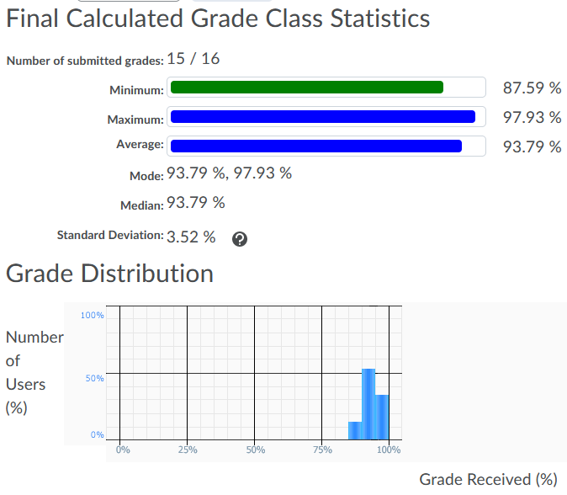
At the moment
At this early moment in time, looking at BS, you are doing well

Slide 20
CutOff
Review BS/web for when the last chance to submit is…
If you miss mandatory exercises…
  Some are BS and some are Crunch exercises
… then be sure, I will poke you
  Ensure I can reach you – I only have your AU mail box

Slide 21
Questions?

Slide 22
Good Luck / Have Fun

